Slide 1
OOP PROJECT BURGER JOINT
Group Members:
Talal Khan(25253)
Saad Lakhani(24471)
Nimra Humayun(24450)

Slide 2
Index
Project Idea
UML
OOP concepts Used
GUI Screens

Slide 3
Burger Joint (Speedy Snacks)
Idea:
It is a burger joint where you can order different meals of burgers, fries and drinks. There will be different sizes of fries and drinks and the burgers will be custom made. (Number of patties, sauces, bun type etc)
Each item will have a specific price. The GUI will serve as a ordering panel and in the end will tell the total price and display a receipt.

Slide 4
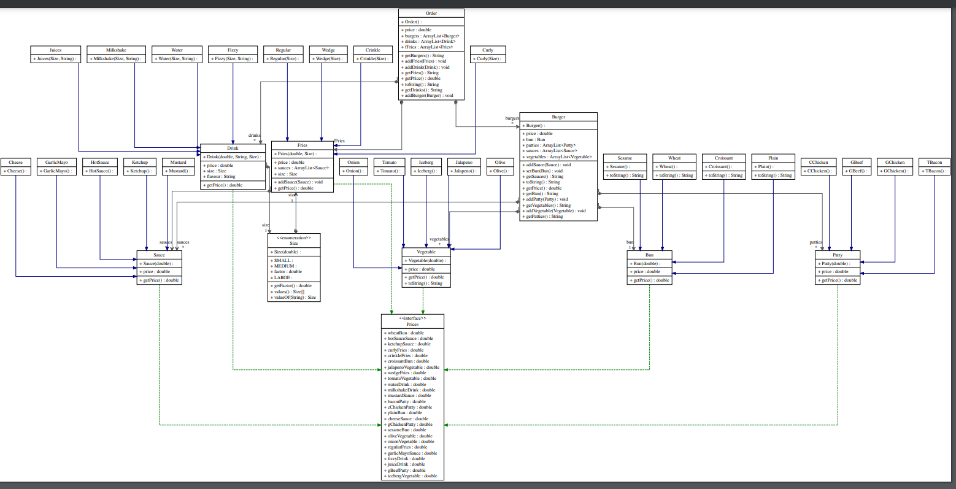
UML

Slide 5
OOP CONCEPTS USED
Interface: An interface named price is created that contains all the prices of the items on the menu and classes burger, drink, and fries are implementing it by taking that variable. Its advantage is that if the owner want to change the price they can do it by changing it in the interface and it will automatically change the value of the class as well.
Array List: An array list is created in the burger class for variables vegetable patty and sauce so that the customers selected sauces vegetables and meat are stored in their respective variable in form of array list.
Inheritance: Parent classes have various subclasses inheriting their methods like regular wedge and crinkle are subclasses extending from its parent class which is Fries. Drinks bun patty etc are also other parent classes having their own sub classes.
Association: Has a relationship is being displayed between order & patty, order& burger, order &drinks to use the services and functionality of the respective object to which its is related. One to one relationship is seen between bun and burger while one to many is seen between patty and burger.
Aggregation: burger and order both stand on their own.
Composition: sauce cannot exist without burger or fries.
Exception Handling: Various exception are used in GUI like class not found exception, Illegal Access Exception.
Polymorphism: It is used in various places for example different classes like milkshakes water juices are all stored in one single array list that is initialized by Drink
File I/O : This concept is used to store the final receipt of the order in a text file.
Abstraction: it is used in the parent classes of burger, patty, fries etc to give a blueprint.
Enum: Is used to store the size factors. For example; Medum is 1x, Large is 1.5x and small is 0.75x. The following constants are called wherever size is needed.

Slide 6
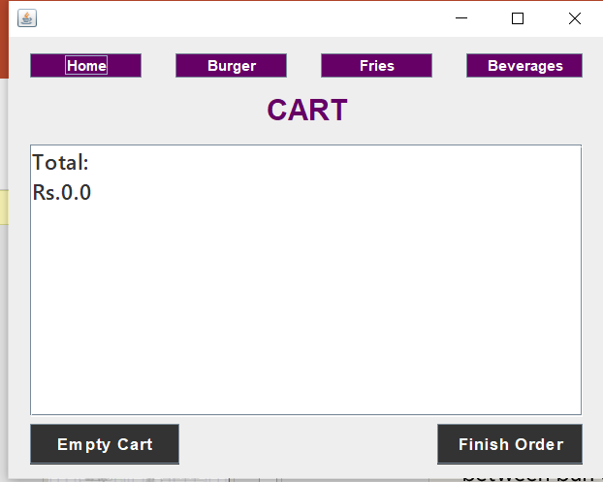
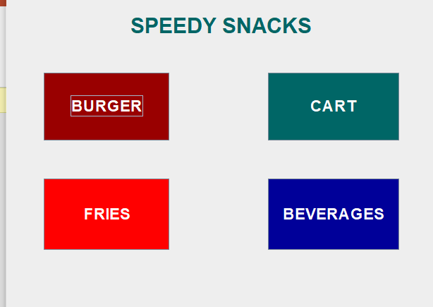
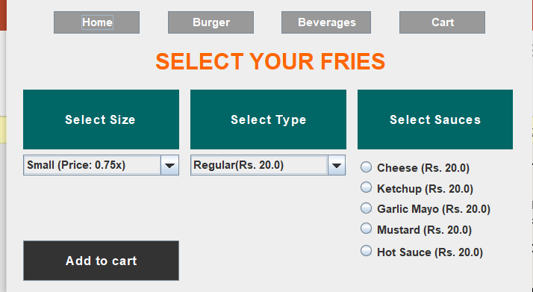
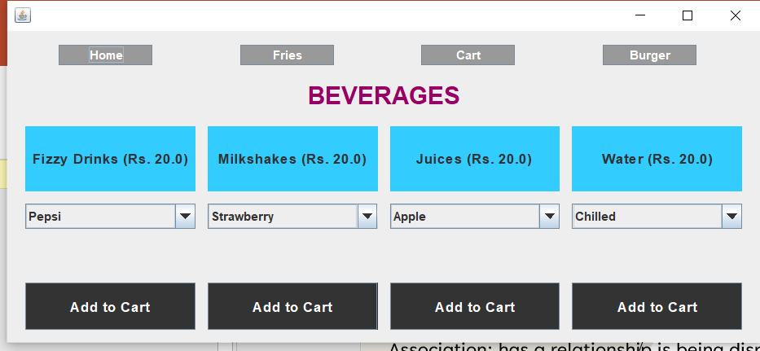
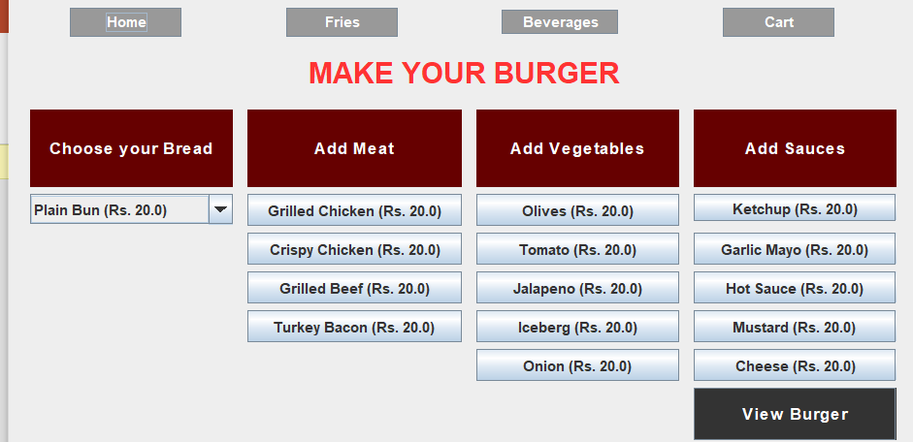
GUI SCREENS
CART WINDOW
FRIES WINDOW
HOME SCREEN
BEVERAGES WINDOW
BURGERWINDOW

Slide 7
Thank You

